Slide 1

Intro to the graphical multiplicity procedure and the gMCP package

Slide 2
Outline
Today’s gathering
Introduction to the graphical procedure
Main results from seminal papers
Introduction to the gMCP package
Some hands-on demo and opportunity to use the gMCP package GUI. This requires either
Recommended: 64-bit Java installed (available at AskIT, with special instruction note that 64-bit is needed) and a 64-bit version of R
32-bit Java installed (available at AskIT) and a 32-bit version of R (NB: R 4.1 is the last version that supported 32-bit versions)
Overview of process to compare multiple candidate graphs with some coded examples
Next time
Extensions of the Graphical Procedure
Group sequential designs
Other adaptive designs with interim analysis opportunities

Slide 3

Pre-work for workshop
Please ensure you are using
You’re using a 64-bit version of R.
With an existing version of R installed via IT, you should be able to update to latest version of R via CRAN.
Please ensure that you have
Java installed
Available at AskIT – general application request
In ‘Short Description’: Java 64-bit is needed for the gMCP package to be used with the R programming Software.
Expect to encounter an error if the appropriate version of Java is not installed. (32-bit R versions require a 32-bit version of R. R 4.1 is the last version that supported 32-bit versions, hence the recommendation to move to 64-bit R)
Please ensure that you’ve installed the gMCP package
As you’re interacting with AskIT, consider if now is a good time for you to
Upgrade to R 4.3.0
Upgrade to appropriate version of Rtools corresponding to v4.3 for those who need this ← likely requires admin password
Upgrade to latest version of Rstudio to avoid pop-up reminders ← requires admin password

Slide 4


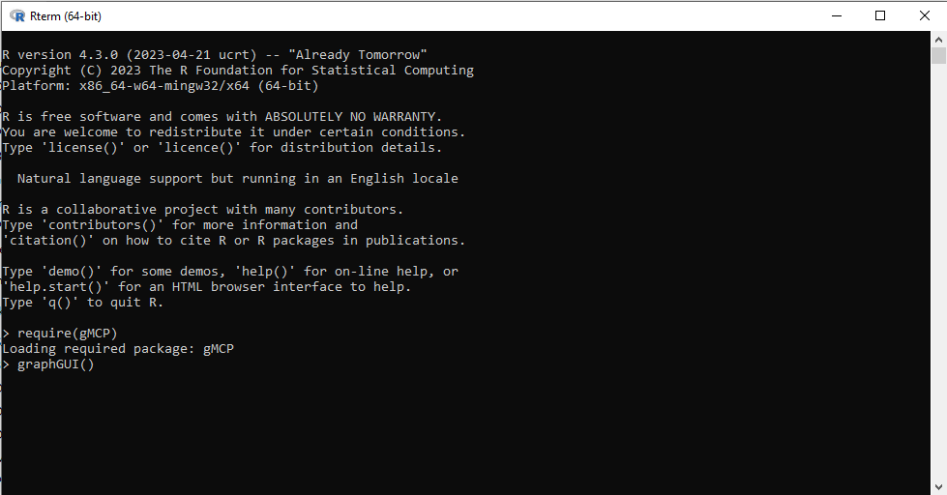
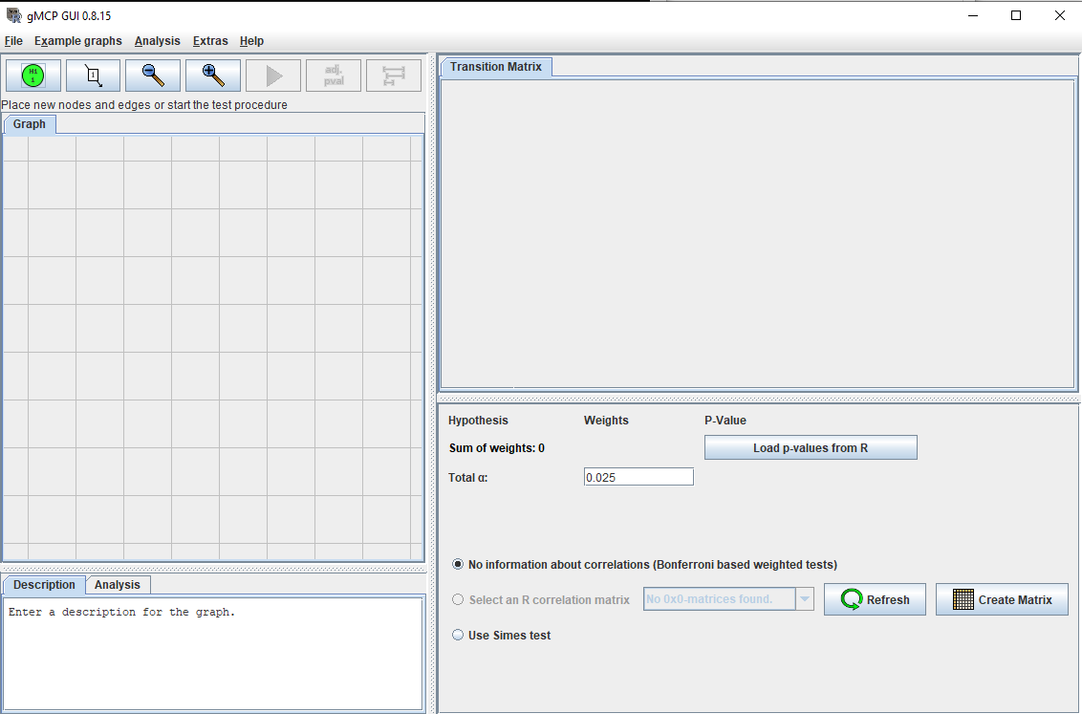
Pre-work for workshop: Steps to load the gMPC’s GUI – this must be done outside of RStudio
Locate the bin folder where your version of R (with gMCP installed) is found
Run R.exe
Call the gMCP package
Run gMCP::graphGUI()
1
2
3
4

Slide 5
Pre-work for workshop
If your call to graphGUI() brings up this window you are ready to go!

Slide 6
Graphical Testing Approach Summary
User builds a graph that captures
The collection of hypotheses for which type I error control is required: These form the nodes of the graph
The initial allocation of type I error weight to a subset of hypotheses
Typically, initial allocation is associated with the primary endpoint tested on one or more doses
Directed arrows between notes dictates how Type I error is propagates to subsequent hypotheses
Typically, subsequent hypotheses are those deemed most important among the remaining hypotheses
The algorithm sequential rejects hypotheses. The collection of rejected hypotheses is unique regardless of order they are rejected.
Algorithm dictates how to update the graph after rejecting a hypothesis
Theoretical results establish that the order in which hypotheses are rejected is inconsequential
Familywise error rate is guaranteed
Closed testing principle is employed
Intersection tests based on weighted Bonferroni tests are recommended
References will go into much greater detail
These basics are sufficient to build and explore the operating characteristics of your own graphs with the gMCP package.

Slide 7
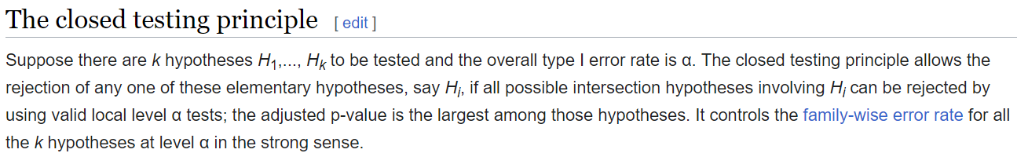
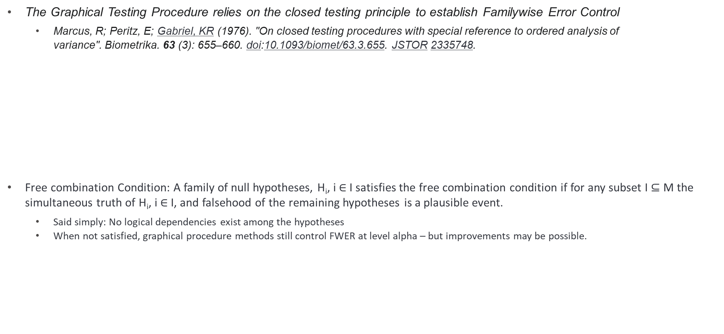
Reference: Theory relies on the closed testing principle
The Graphical Testing Procedure relies on the closed testing principle to establish Familywise Error Control
Marcus, R; Peritz, E; Gabriel, KR (1976). "On closed testing procedures with special reference to ordered analysis of variance". Biometrika. 63 (3): 655–660. doi:10.1093/biomet/63.3.655. JSTOR 2335748.
Free combination Condition: A family of null hypotheses, H_{i}, i $∈$ I satisfies the free combination condition if for any subset I $⊆$ M the simultaneous truth of H_{i}, i $∈$ I, and falsehood of the remaining hypotheses is a plausible event.
Said simply: No logical dependencies exist among the hypotheses
When not satisfied, graphical procedure methods still control FWER at level alpha – but improvements may be possible.

Slide 8
Aside: Tangentially related packages/functions in R
Some other packages and functions of interest
See the R package CTP
Library of functions to design and analyze closed testing procedures for the comparison of population parameters based on independent samples.
See the R package asd for adaptive seamless designs
See asd::combn.test
Implements weighted inverse normal and Fisher combination tests for combining p-values for adaptive seamless designs.
The basic ideas of the combination test approach were proposed by Bauer and Kieser (1999) and make use of a combination function (Bauer and Kohne, 1994) to combine stagewise p-values to allow for interim adaptations and the application of the closed test principle (Marcus et al., 1976) to control the overall test size across multiple hypotheses.
Other multiplicity related packages/functions of interest
multcomp: Simultaneous Inference in General Parametric Models
Simultaneous tests and confidence intervals for general linear hypotheses in parametric models, including linear, generalized linear, linear mixed effects, and survival models. The package includes demos reproducing analyzes presented in the book "Multiple Comparisons Using R" (Bretz, Hothorn, Westfall, 2010, CRC Press).
Multiple Comparisons Using R
stats::p.adjust: Given a set of p-values, returns p-values adjusted using one of several methods.
Methods include: The adjustment methods include the Bonferroni correction ("bonferroni") in which the p-values are multiplied by the number of comparisons. Less conservative corrections are also included by Holm (1979) ("holm"), Hochberg (1988) ("hochberg"), Hommel (1988) ("hommel"), Benjamini & Hochberg (1995) ("BH" or its alias "fdr"), and Benjamini & Yekutieli (2001) ("BY"), respectively. A pass-through option ("none") is also included.

Slide 9
Reference: An algorithm for updating a graph after rejecting a hypothesis
For each intersection ⋂︀_{𝑗∈𝐽} 𝐻_{𝑗} , 𝐽 ⊂ 𝐼 a graph 𝐺_{𝐽} can be derived from 𝐺_{𝐼} and the weights for the weighted local test for ⋂︀ _{𝑗∈𝐽} 𝐻_{𝑗} are the weights of the nodes of 𝐺_{𝐽} .
To derive graph 𝐺_{𝐽} remove all nodes that are not in 𝐽 and update the edges of the graph according to Algorithm 1 (the order does not matter)
Bretz et al. (2009) establishes the weights are unique: They do not depend on the sequence in which hypotheses are removed.

Slide 10
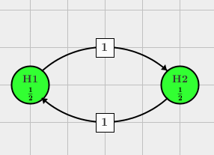
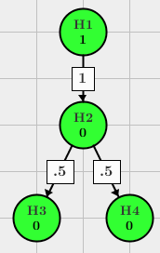
Graph basics
Graph based multiple test procedures are closed test procedures, i.e., for a family {𝐻_{𝑖} | 𝑖 ∈ 𝐼}, 𝐼 = {1, . . . , 𝑛} of elementary hypotheses each intersection ⋂︀𝑗∈𝐽 𝐻_{𝑗} , 𝐽 ⊂ 𝐼 is tested with a local level 𝛼 test.
Following the closed testing principle one can derive a multiple test procedure that controls the family-wise error rate (FWER) at level 𝛼.
Hypotheses are represented by vertices
Associated weights denoting the local significance levels α₁, α₂,…, α_{n}, α_{i} ≥ 0 and Σα_{i} = 1
Weights with g_{ij} = 0 indicate that no propagation of the significance level is foreseen and the edge is dropped for convenience.
When two vertices, H_{i} and H_{j} are connected through directed edges, the associated weight g_{ij} indicates the fraction of the local significance level α_{i} that is propagated to H_{j} once H_{i} has been rejected.

Slide 11


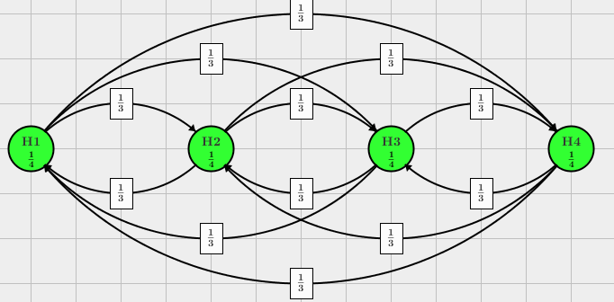
Bonferroni vs. Bonferroni-Holm with 2 and 4 hypotheses
Bonferroni: We can describe this multiplicity adjustment as a graph without and connecting edges.
Bonferroni-Holm: We can describe this multiplicity adjustment as a well-connected graph using equal weights along all edges.

Slide 12


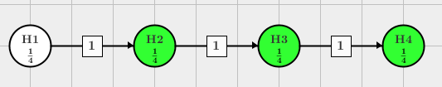

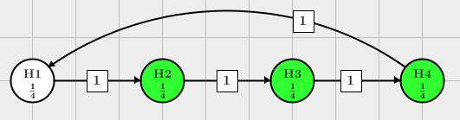

Fixed Sequence, Fallback, Improved Fall back
Let’s recreate this in the GUI.
Try each with p-values = c(.01, .001, .001, .001) and overall type I error set to 0.025. Purple = Reject; White = retain.
NB: Graph terminates without ability to reject H₁.
As, each p-value is less that 0.05, all are rejected.
Since H1 has .01 > 0.025/4 = 0.00625 H1 is retained.
What is largest p-value H₃ could have and still reject?
.025*1/4 + .025*1/4 = .0125
Alpha propagation lesson: Don’t leave alpha on the table!
By recycling back to top, improved fallback from H₁ ultimately compares vs. .025*3/4 = .01875 leading to rejection.

Slide 13
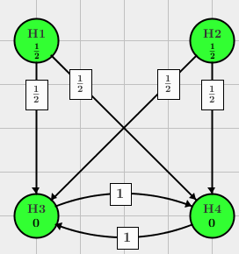
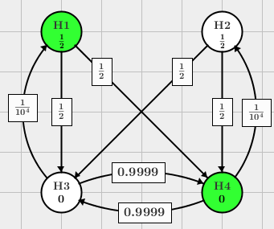
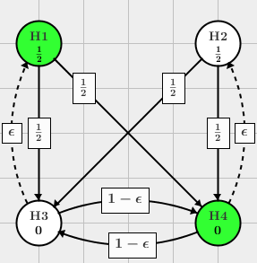
Parallel Gatekeeping, Improved parallel gatekeeping, & epsilon replaced with small but positive value
What does Graph on left suggest about team’s view of relative importance of the H₁, H₂, H₃, H₄?
What improvements are offered by the generalized version of the center graph?
Note that the final graph allows us to think of generalization of the previous graph.
No recycling employed!
We can do better!
Having rejected H₁ and H₃, priority is H₄, not H₂.
Having rejected H₂ and H₄, priority is H₃, not H₁.
Taking various values of ε leads to different graphs and different behavior. Simulation will help assess.

Slide 14
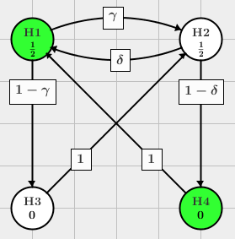
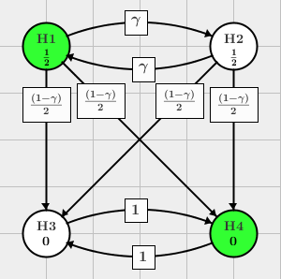
Truncated Holm Procedure vs. Simple Successive Graph
What does Graph on left suggest about team’s view of relative importance of the H₁, H₂, H₃, H₄?
What does generalized version on the right allow the team to accomplish?
Truncated Holm Procedure
Taking γ = 0.95 would imply ___________
Taking γ = 0.05 would imply ___________
Taking γ = 0.95 and δ = 0.05 would imply ___________
Taking γ = 0.05 and δ = 0.95 would imply ___________

Slide 15
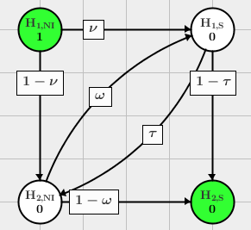
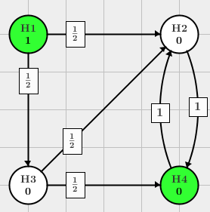
Non-inferiority/Superiority & Composite/Components
Graph representing the procedure from Hung and Wang (2010)
$H_{1,NI}$ : Non-inferiority of the primary endpoint
$H_{1,S}$ : Superiority of the primary endpoint
$H_{2,NI}$ : Non-inferiority of the secondary endpoint
$H_{2,S}$ : Superiority of the secondary endpoint
Graph representing the procedure from Huque, Alosh and Bhore (2011)
E.g.,
H1 = MACE,
H2 = non-fatal MI,
H3 = CV Death,
H4 = non-fatal Stroke

Slide 16
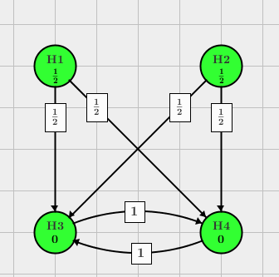
To the GUI
Goal: Build/recreate the graph
Step through the graph using the following p-values
.0124, .0126, .001, .02495
.0124, .0132, .001, .01
.0124, .0122, .001, . 02495

Slide 17
Towards comparing candidate graphs
Let’s assume you have
A collection of graphs of interest, G₁, G₂, …, G_{g}
A means to simulate p-values for the hypotheses of interest
You may have access to a previously run trial with exact same endpoints
Bootstrap sampling might be employed to generate p-values for elementary hypotheses
Ideal if your previous trial is suitably large and in the same patient population
Appeal to simulation
Approach 2a: You have ability to simulate patient level responses
Ideally you have information on the correlation structure and can incorporate this
In the absence of this information, you might run sensitivity analyses with candidate correlation structure to see how robust results are to the unknown correlation structure
Simulated patient level responses are then used to create a simulated clinical trial from which p-values are collected.
Approach 2b: You have ability to simulate multivariate test statistics
Avoids the need to simulate patient level data
MV Normal distributed test statistic with some correlation (again, ideally based on data) structure can be used to vectors of test statistics which can then be converted to p-values

Slide 18
Comparing Candidate Graphs
Create a large number of simulated vector of p-values
Push each vector of p-values to each graph: G₁, G₂, …, G_{g}
Input vector is vector of p-values
Output vectors O₁, O₂,…, O_{g} reports the retain/reject status of elementary hypotheses based on graphs G₁, …, G_{g} , respectively
Repeat step 2, estimate the rejection rates of elementary hypotheses
Determine which graphic is meeting team’s needs

Slide 19
Simulation based approach to comparing graphical designs
Assume we have the following
A list of elementary hypotheses
A means of simulating or creating p-values for the elementary hypotheses
Candidate graphs
Let’s step through some code with an example

Slide 21
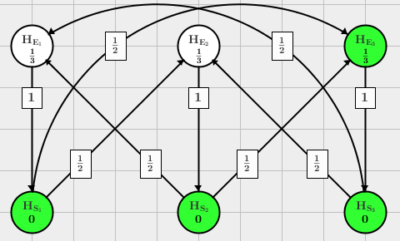
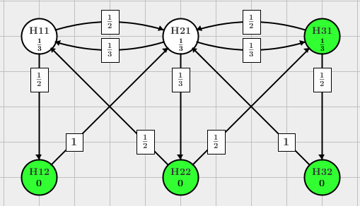
Efficacy/Safety & Primary/Secondary in 3-arm
E₁, E₂, E₃ are efficacy endpoints
S₁, S₂, S₃ are safety endpoints
What is this graph communicating?
Safety is only important when Efficacy is rejected.
Having a pair with Efficacy and Safety is very important
Graph representing the procedure from Bretz et al. (2011) - Figure 2
H11, H21, and H31 ~ Primary endpoints for 3 doses
H21, H22 and H23 ~ associated secondary hypotheses.
What is this graph communicating?
There’s a preference to win primary endpoints
A secondary hypothesis is only tested if the associated primary hypotheses is rejected.

Slide 22
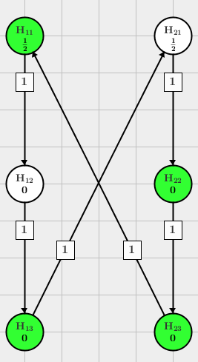
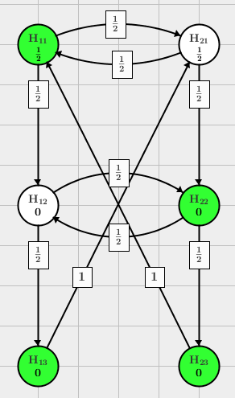
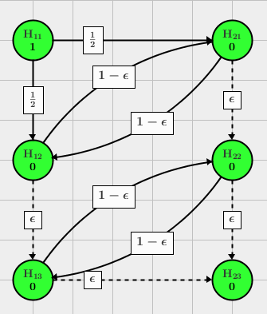
‘Primary’, ‘Secondary’, ‘Tertiary’ endpoints Editorial comment: Underscore to teams these adjectives are meaningless to regulators who distinguish between endpoints that have and do not have Type I error control

Slide 23
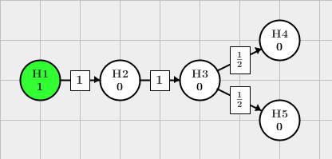
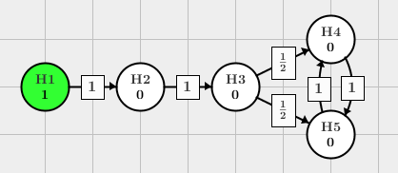
A reminder that we should be mindful: ‘Don’t leave alpha on the table’
Initial Graph
These hypotheses are represented in the graph as follows:
H1: drug B better than placebo
H2: drug C better than placebo
H3: drug A better than placebo
H4: drug A better than drug B
H5: drug A better than drug C
Improved Graph
Improve the test procedure by using a Bonferroni-Holm correction instead of the Bonferroni correction in the last step: add an edge from H4 to H5 with weight 1 and vice versa.

Slide 24
Your turn
Suppose we have an analysis of variance setting.
Does the frequency of spam emails differ by day of the week?
H1: Global F test
H2: Weekends differ from Weekdays
H3: Monday/Fridays differ from rest of the week
H4: Friday differs from rest of the days
5 arms + control dose ranging study

Slide 25
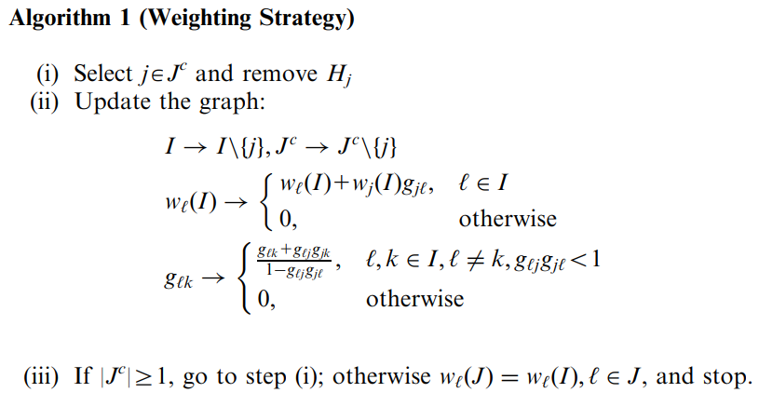

Algorithm 1 (weighting strategy)
Weighting strategies are formally defined through the
weights w_{i}(I), I in I, for the global null hypotheses H_{I} and
transition matrix G = (g_{ij}) where g_{ij} in [0, 1] and $\sum_{i=1}^{m}{g_{ij}}≤1$ for all i in I.
For a given index set J ⊆I, let J^{c} = I\J denote the set of indices that are not contained in J.
The algorithm determines the weights w_{j}(J), j ∈ J
This algorithm has to be repeated for each J ⊆I to generate the m2^{m-1} weights for the full closure
Bretz et al. (2009) establishes 1) the weights w_{j}(J), j ∈ J and 2) weights do not depend on the sequence in which hypotheses H_{j}, j ∈ J^{c} are removed

Slide 26
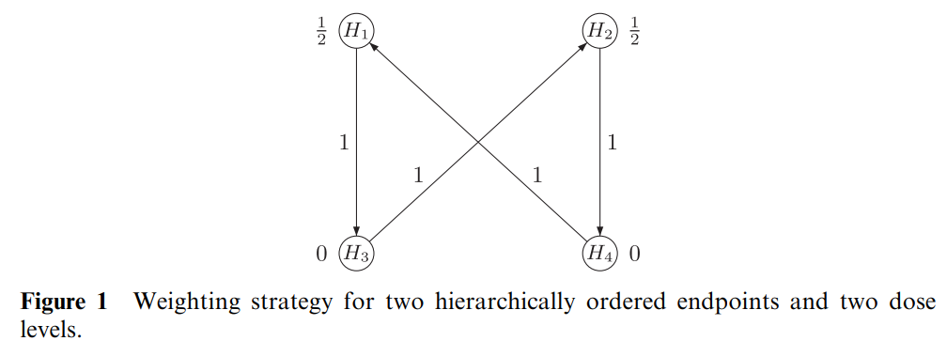
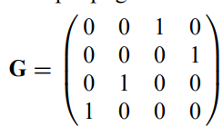
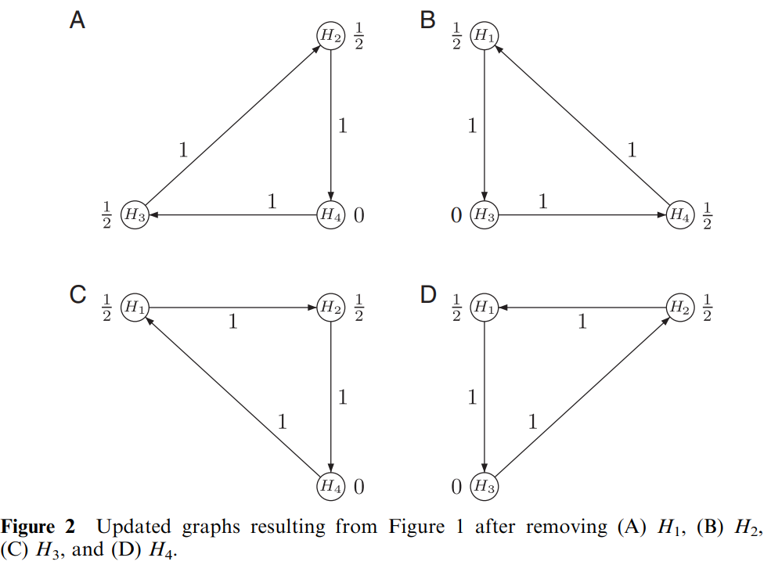
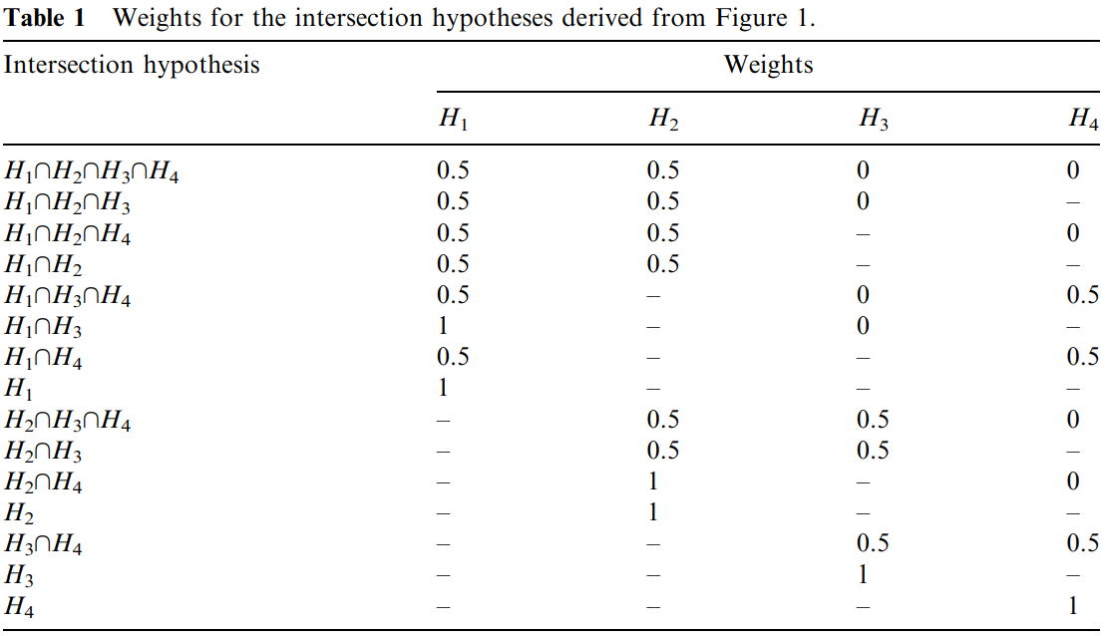

Slide 27
Many standard approaches from the literature can be visualized using Bonferroni-based graphical test procedures,
weighted or unweighted Bonferroni–Holm procedure (Holm, 1979),
fixed sequence tests (Maurer et. al, 1995; Westfall and Krishen, 2001),
fallback procedures (Wiens, 2003), and
gatekeeping procedures (Bauer et al., 1998; Westfall and Krishen, 2001; Dmitrienko et al., 2003).
the gMCP package in R, which offers a convenient graphical user interface (GUI) for these approaches.

Slide 28
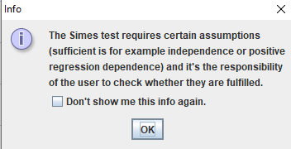
Generalizations of the Bonferroni-based graphs
One general disadvantage of Bonferroni-based approaches is a perceived power loss, motivating the use of weighted parametric tests that account for the correlation between the test statistics or the use of weighted Simes tests.
Weighted parametric tests assume the joint distribution of the p-values are known. If so, a weighted min-p test can defined.
As this assumption is rarely met, we’ll skip.
However, for a given weighting strategy, weighted parametric approach would be uniformly more powerful than Bonferroni-based.
If some, but not all of the MV distributions of p-values is known, one may derive conservative upper bounds of the rejection probability that still give an improvement over the Bonferroni test.
When the correlations between the test statistics are not exactly known, but certain restriction on them are assumed
E.g., test statistics have a joint MV normal distribution with non-negative correlations.
A weighted Simes test for the intersection hypotheses can be employed.
Again, the requirements required are ‘not always easy to verify or even justify in practice’

Slide 29
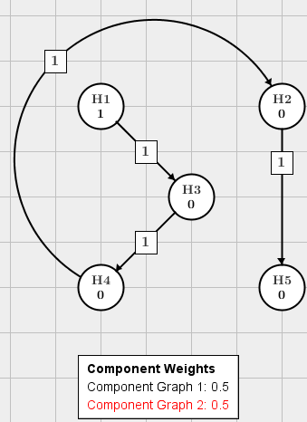
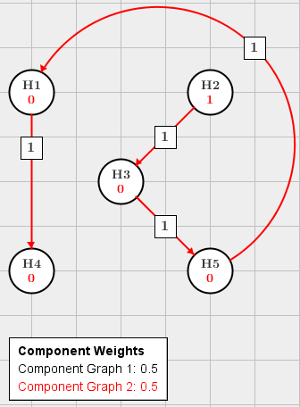
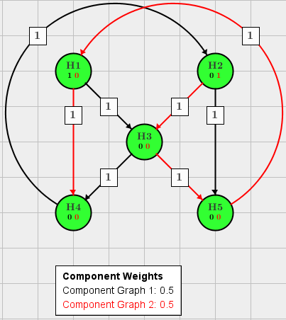
Entangled Graphs
Graph from Maurer and Bretz 2012
H1, H2: Period 1 primary hypotheses of no effect for endpoint (a) comparing low and high dose with placebo, respectively.
H3: Period 2 primary hypothesis of no difference for endpoint (b) comparing drug (by pooling all patients on active treatment) with placebo.
H4, H5: Period 1 key secondary hypotheses of no difference in the proportions comparing low and high dose with placebo, respectively.
Literature: Maurer, W., & Bretz, F. (2013). Memory and other properties of multiple test procedures generated by entangled graphs. Statistics in medicine, 32(10), p. 1739-1753.

